Slide 1


Tips for telephone interviews
INTERNATIONAL AGENCY FOR RESEARCH ON CANCER LYON - FRANCE
e-SMP
Notes:
&&M: Advice: Pagenumber on the same spot every slide.

Slide 2

Materials needed for telephone interview
Introducing telephone interview
Closing the interview
Attention points for telephone interviews
Motivating respondents
GloboDiet training: Telephone interviews
IARC, Lyon - France

Slide 3


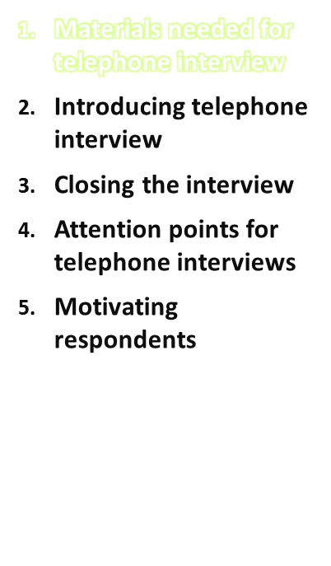
Materials respondent:
  Telephone
  Picture book + bread shapes, etc.
  Respondent form with caseid number etc. if needed
Materials interviewer:
  Telephone + Headset (to keep your hands free during the interview)
  Laptop + charger
  Picture book + bread shapes, etc.
  Pen and paper
  Respondent form with caseid number etc. if needed
GloboDiet training: Telephone interviews
IARC, Lyon - France

Slide 4
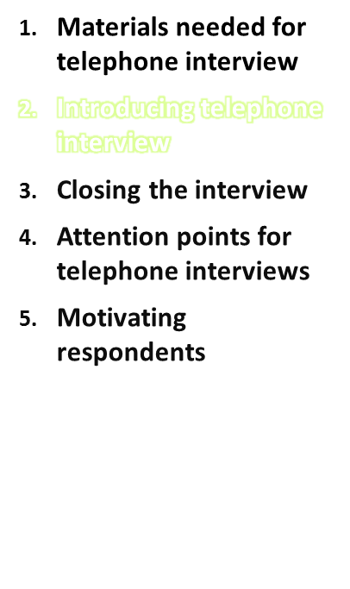
Please use the following check-list before starting the telephone interview:
  Choose private & quiet location for yourself and suggest as far as possible also for the respondent
  Introduce yourself as staff member of your institute and mention that you are calling the respondent regarding the interview that he/she agreed upon for his/her participation in the food consumption survey/study
  Mention that the telephone interview will take about 40 minutes and ask whether this moment is suitable for him/her
  If the respondent won’t have enough time available, then please ask when he/she will be available for this 40 minutes interview
GloboDiet training: Telephone interviews
IARC, Lyon - France

Slide 5
Introducing telephone interview
Please use the following check-list before starting the telephone interview (continued):
  Ask the respondent whether he/she has the picture book (and any other materials that were sent in advance) in front of him/her
  If the respondent did not receive the necessary materials, then please inform the person responsible for the mailing of the materials and make a new/postponed appointment with the respondent
  Ask whether the respondent has measured him/herself and if he/she can take these measurement results with him during the interview
  Please explain the procedure of the GloboDiet 24-h recall:
    to recall all foods and drinks consumed the day before between waking up the day before and waking up today)
    Existing out of 3 main parts: general questions, quick list to have a quick overview of foods and drinks consumed the day before while remembering activities done day before, detailed questions to describe and quantify foods consumed in more depth
    Explain use of the picture book, ruler, household measures and bread shapes
    Explain that you will enter all the answers in a software during the interview
GloboDiet training: Telephone interviews
IARC, Lyon - France

Slide 6
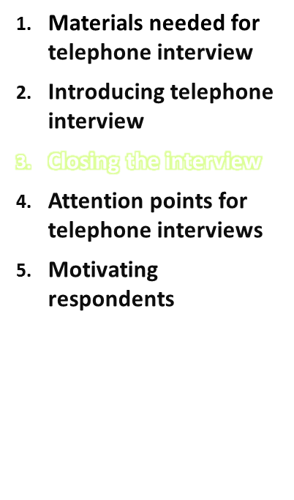
Closing the interview:
  Ask the respondent whether he/she has any remaining questions
  Thank the respondent for his/her participation
  If this is the first interview of a duplicate or set of interviews then please mention that you will call the respondent again in some weeks time and ask the respondent to keep the picture book solicitously
  If this is the last 24-h recall interview then please ask the respondent to send back the materials (e.g. picture book) to the coordinating institute if necessary
GloboDiet training: Telephone interviews
IARC, Lyon - France

Slide 7
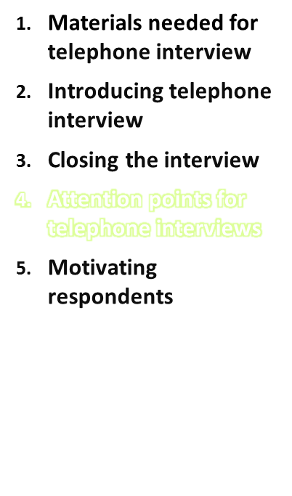
Attention points for telephone interviews:
  Please be always reminded that the respondent cannot see the interviewer
  Try to avoid silent moments (please tell the respondent what you are doing if you need some time to enter data or to search for some information)
  Please be aware that you need to speak very clearly through the phone and more in particular for elderly
  If someone else from the household/family can provide extra information about any foods or recipes, then please allow this person to add extra information
GloboDiet training: Telephone interviews
IARC, Lyon - France

Slide 8
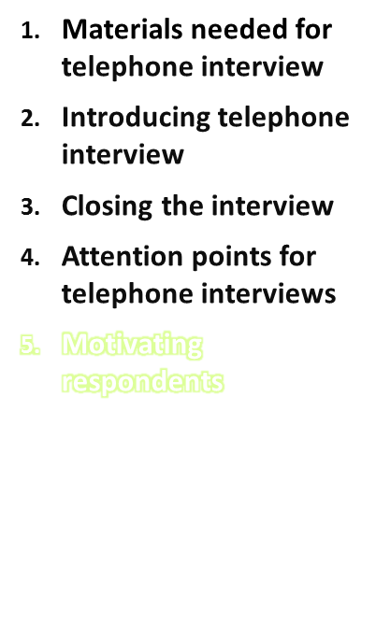
If the respondent won’t have time to participate, he/she is likely to use the following arguments:
  No time
  Not the right timing
  Not in the mood
  What is the benefit for him/her
  Please try the following counter arguments:
  Ask whether you can call back another time and what time that would suit the respondent most
  Clarify the aims of the study in more depth and explain why the participation of the respondent is so important for the study
  Underline the anonymity
  Underline that it will only take about 40 minutes up to an hour
  Please insist also that it is no problem for the recall if the previous day was an exceptional day
GloboDiet training: Telephone interviews
IARC, Lyon - France

Slide 9
    We would like to acknowledge the team involved in the National food consumption survey in the Netherlands (RIVM) for providing us with these tips for collecting telephone interviews
Materials needed for telephone interview
Introducing telephone interview
Closing the interview
Attention points for telephone interviews
Motivating respondents
GloboDiet training: Telephone interviews
IARC, Lyon - France

